Slide 1
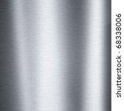

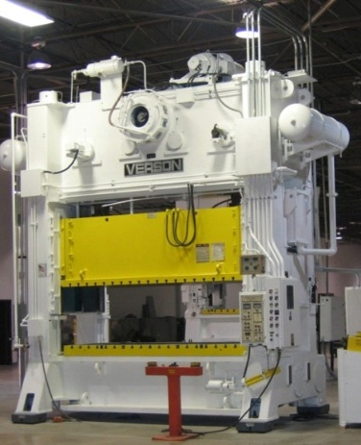
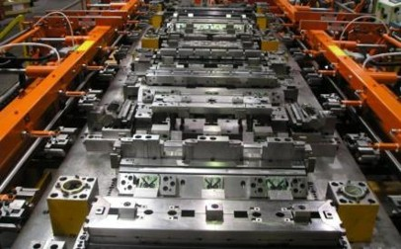
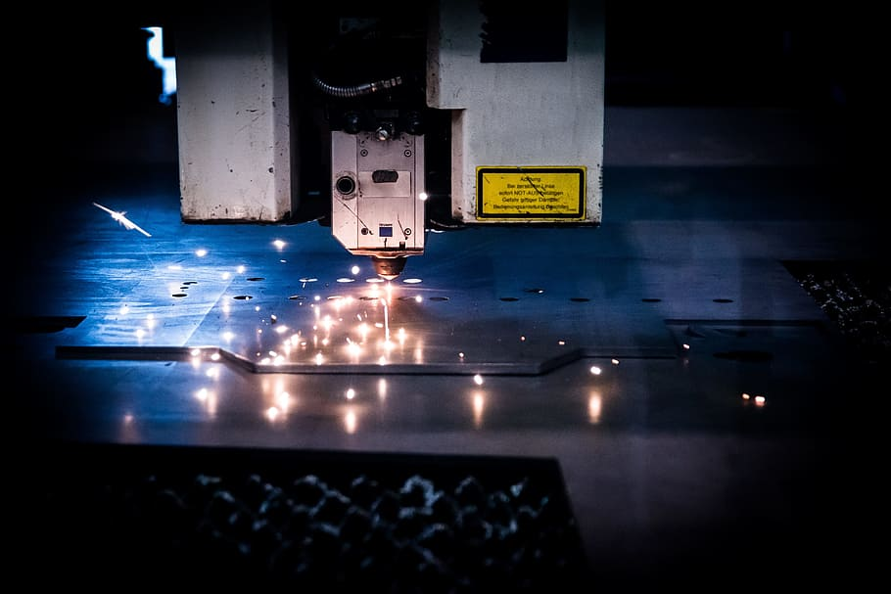
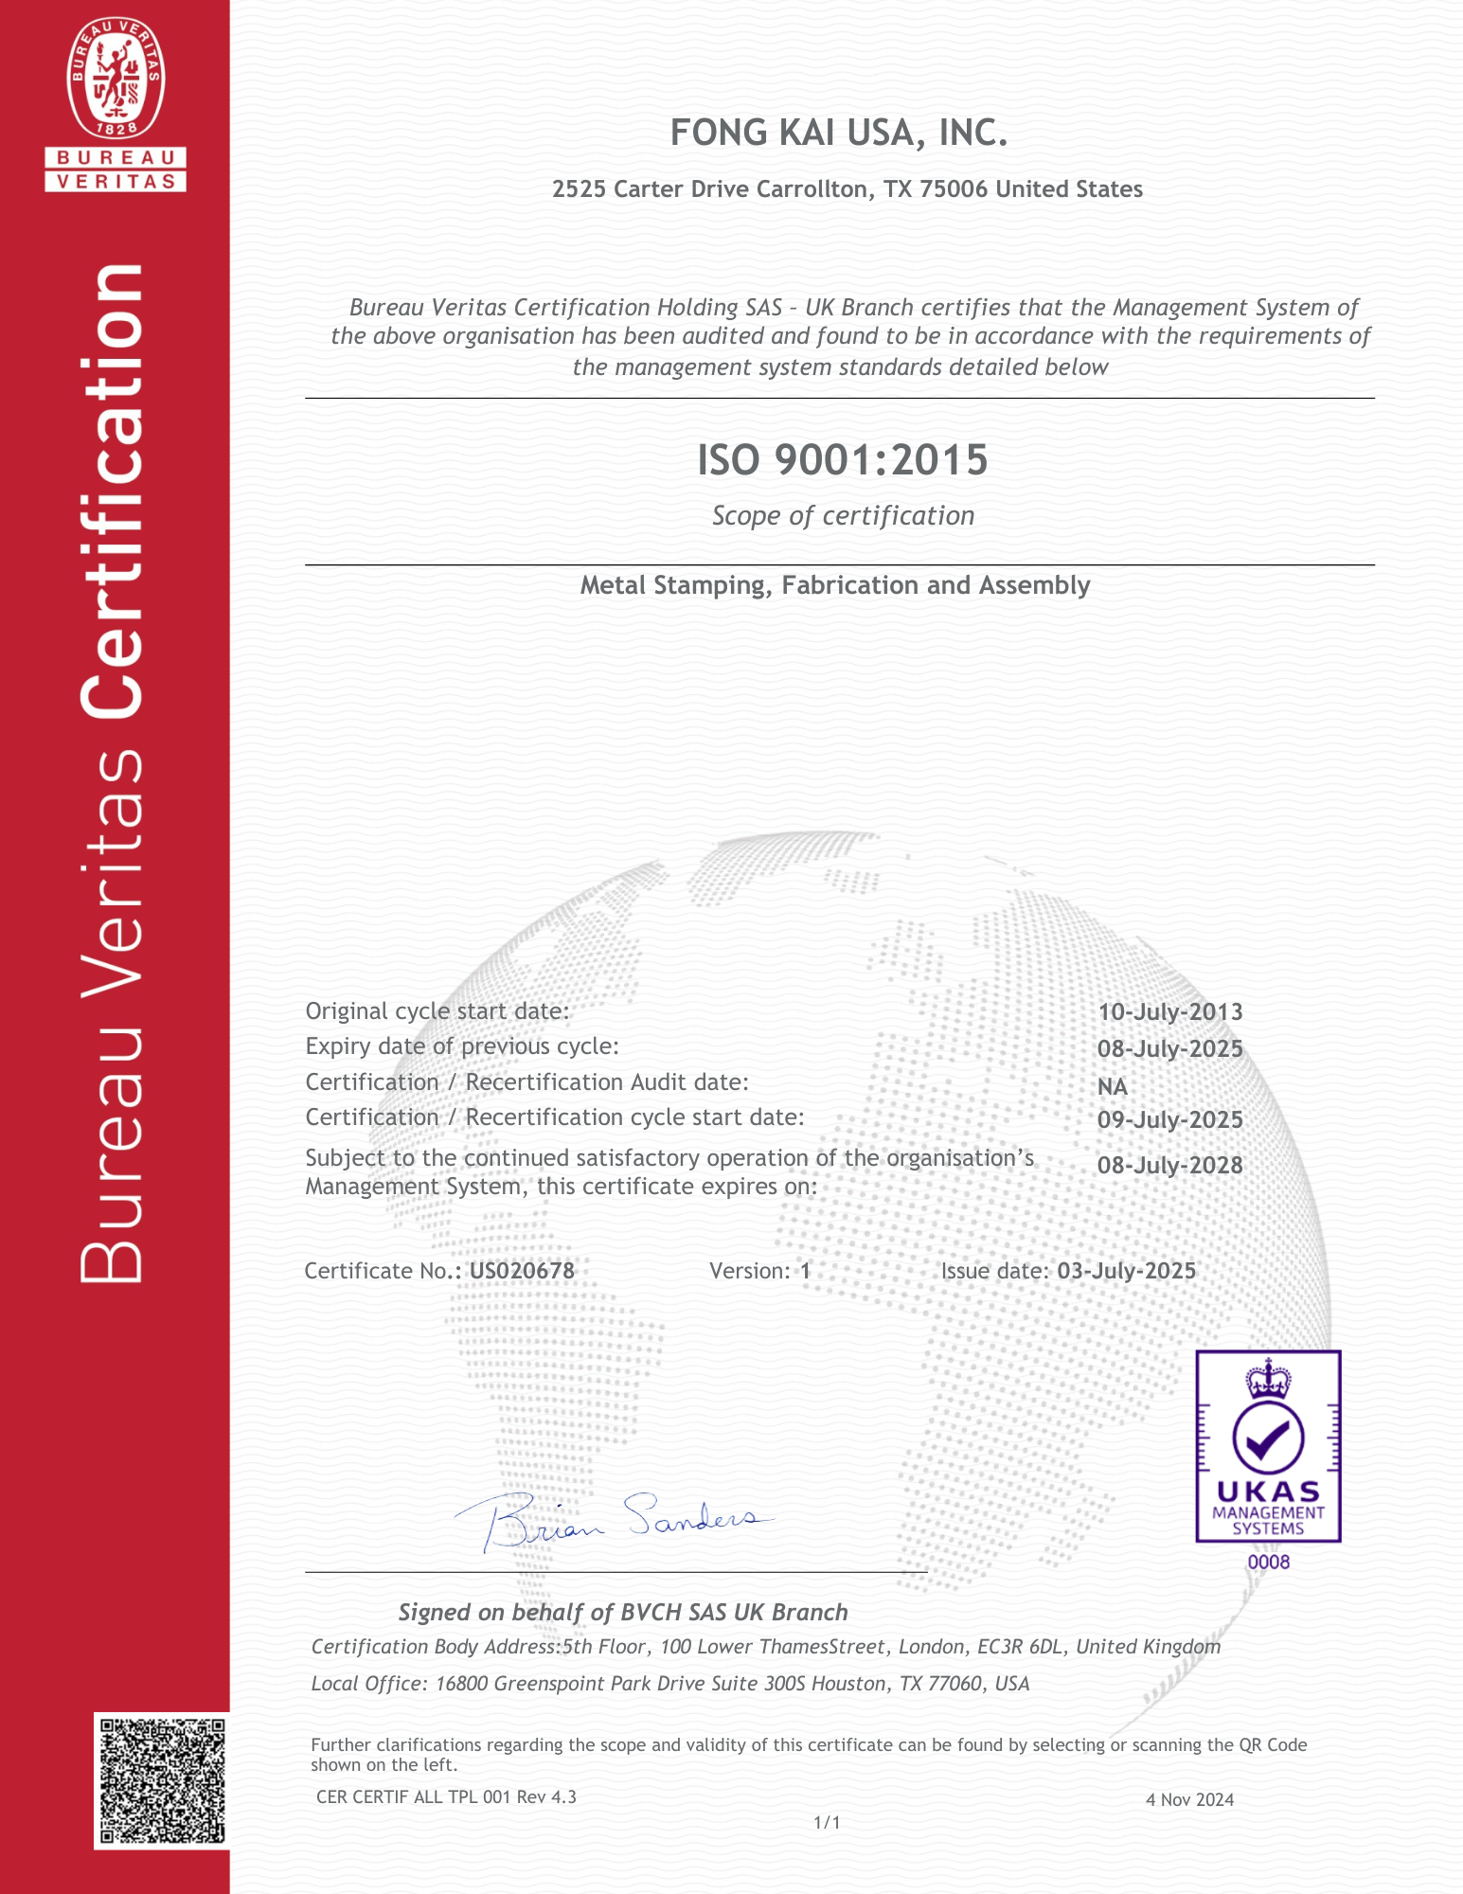
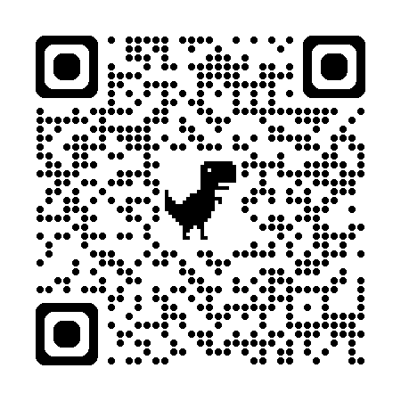
Precision Metal Fabrication & Stamping
We are a precision metal fabrication and stamping provider with over 20 years of experience serving aerospace, industrial, appliance, transportation, consumer electronics, and construction sectors.
Tight Tolerance metal stampings up to 600 tons
Custom Fabrication for complex assemblies
Rapid Prototype and scalable production
ISO 9001-2015 certified Processes
WWW.FKIUSA.Net
Sean@fongkai.com

